Slide 1
Mathematics in Deep Learning
王立威
北京大学 信息科学技术学院
wanglw@pku.edu.cn

Slide 2



Machine Learning Breakthrough:
Deep Learning
Deep Reinforcement Learning

Slide 3
Content
Supervised Learning and Deep Learning
Open Problems
Recent Works
Conclusions

Slide 4
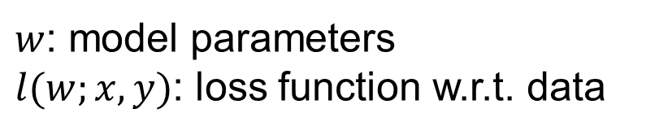
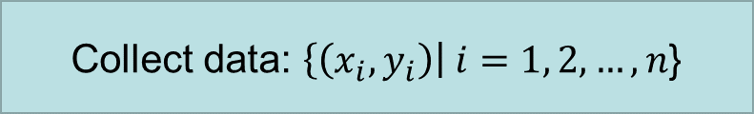
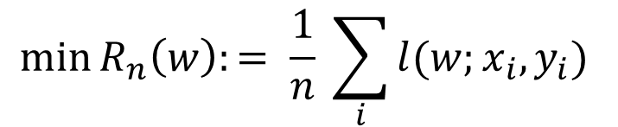


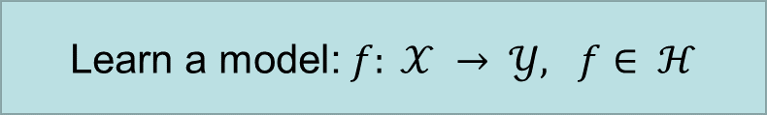
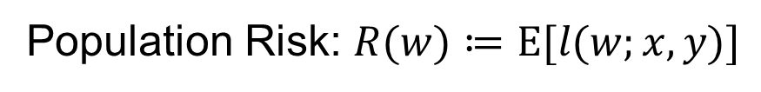
Supervised Learning
All $\left(x,y\right) \sim 𝒟$, where $𝒟$ is unknown
Collect data: $\left\{\left(x_{i},y_{i}\right)\right| i=1, 2, …, n$}
A common approach to learn:
ERM (Empirical Risk Minimization)
Learn a model: $f: 𝒳 → 𝒴, f∈ ℋ$
$$\min{R_{n}\left(w\right):= \frac{1}{n} \sum_{i}{l(w;x_{i},y_{i})} }$$
$w$: model parameters
$l(w;x,y)$: loss function w.r.t. data
Predict new data: $x →f(x)$
Population Risk: $R(w)≔E[l(w;x,y)]$

Slide 5
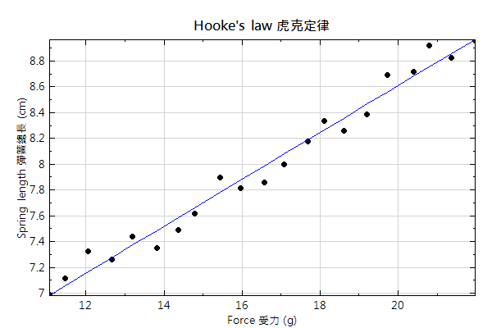
Machine Learning is not new
Hook’s Law
Kepler’s Law

Slide 6
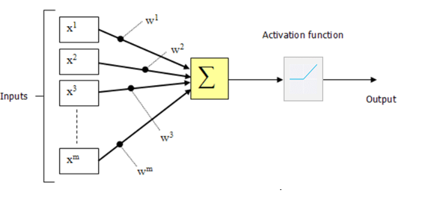

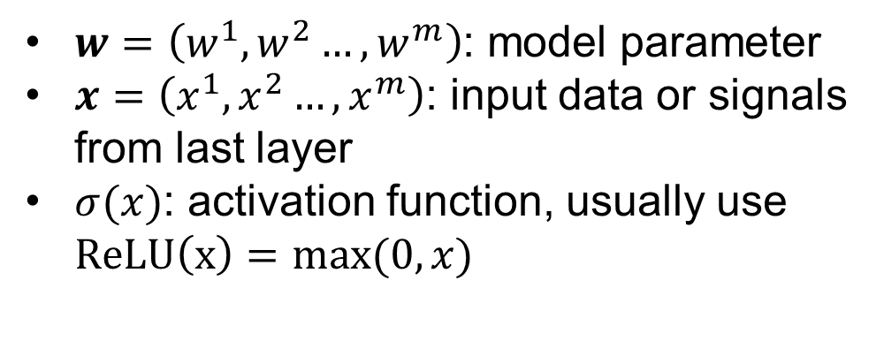
Deep Learning
Each neural do some calculation on previous inputs
$$x_{output}= σ(w⋅x)$$
$w=\left(w^{1},w^{2}…,w^{m}\right)$: model parameter
$x=\left(x^{1},x^{2}…,x^{m}\right)$: input data or signals from last layer
$σ(x)$: activation function, usually use $ReLU\left(x\right)=max⁡(0,x)$

Slide 7
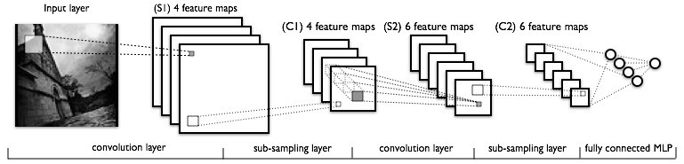
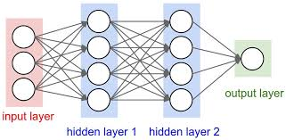
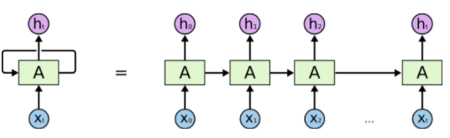

Deep Learning Method
Main idea: using layer-wise structures to represent hypothesis set
Spatial
CNN
Time
RNN
composite function
$$f\left(x\right)= σ_{L}(w_{L}σ_{L−1}(⋯σ_{1}(w_{1}x)))$$
Notes:
这里要讲细节：数学表示每一个neuron的运算。听众可能连这个也不知道

Slide 8
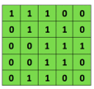
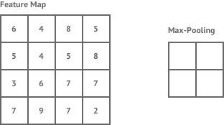
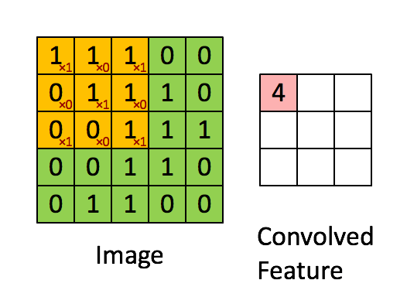

Convolutional neural network
Convolutional layer and pooling layer are specifically designed for image data.
max pooling
2x2 filters
and stride 2
Input matrix
Convolutional
3x3 filter

Slide 9
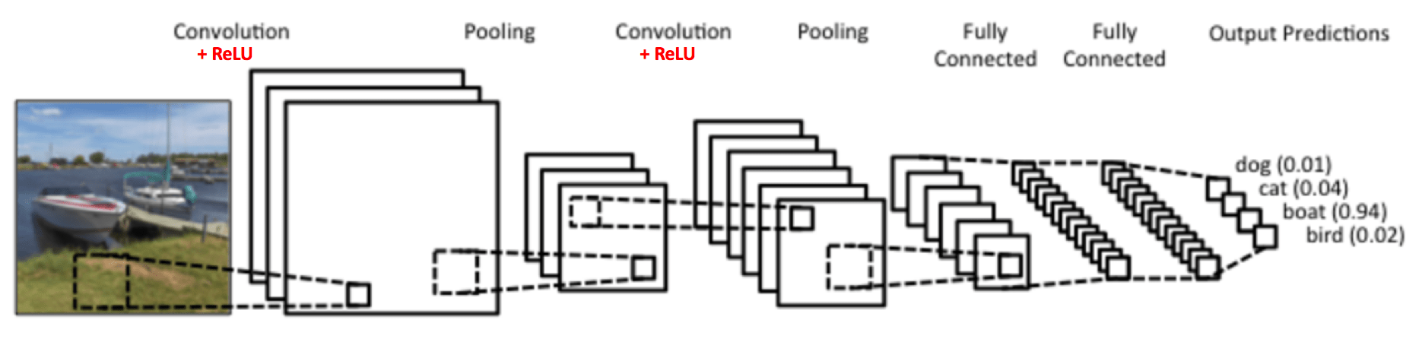
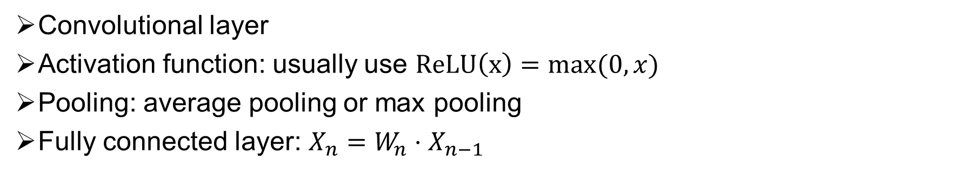
Convolutional Neural Network
Convolutional layer
Activation function: usually use $ReLU\left(x\right)=max⁡(0,x)$
Pooling: average pooling or max pooling
Fully connected layer: $X_{n}=W_{n}⋅X_{n−1}$
Notes:
Convolution也需要细节

Slide 10
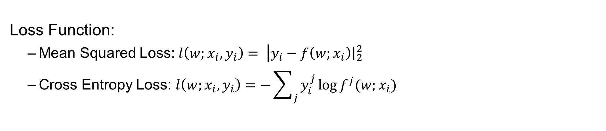
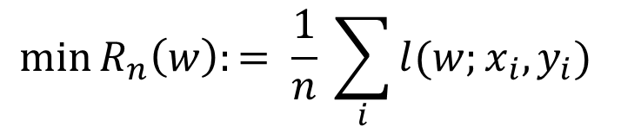
Optimization
Empirical Risk Minimization:
$$\min{R_{n}\left(w\right):= \frac{1}{n} \sum_{i}{l(w;x_{i},y_{i})} }$$
Where $(x_{i},y_{i})$ is the data, $w$ is the parameter vector.
Loss Function:
  Mean Squared Loss:${ l\left(w;x_{i},y_{i}\right)= \left|y_{i}\right.−\left.f\left(w;x_{i}\right)\right|}_{2}^{2}$
  Cross Entropy Loss: $l\left(w;x_{i},y_{i}\right)=−\sum_{j}{y_{i}^{j}\log{f^{j}(w;x_{i})}}$

Slide 11
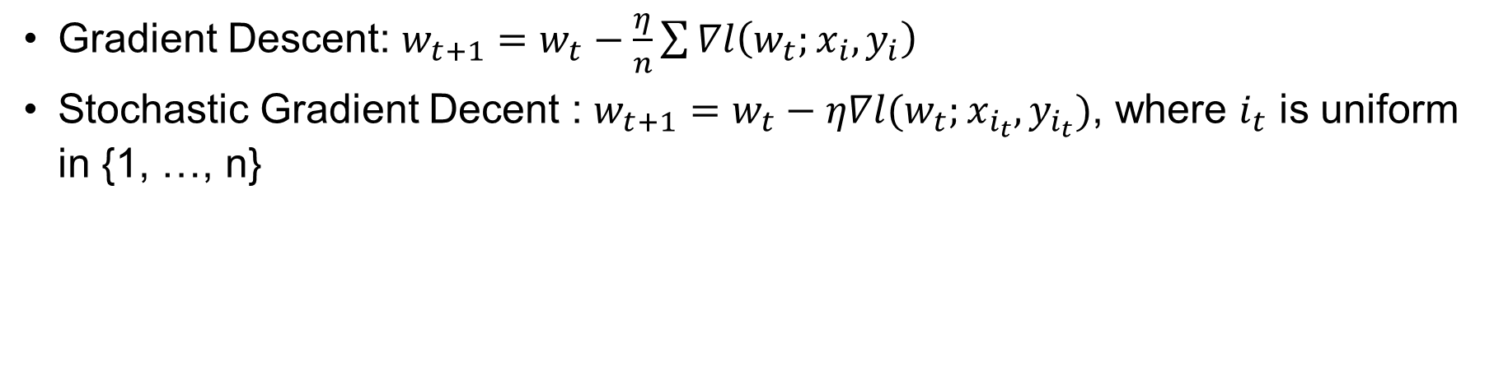
Optimization
Stochastic Gradient Decent (SGD) is the method to optimize this problem
O(n) time complexity
Gradient Descent: $w_{t+1}=w_{t}−\frac{η}{n}\sum{∇l\left(w_{t};x_{i},y_{i}\right)}$
Stochastic Gradient Decent : $w_{t+1}=w_{t}−η∇l(w_{t};x_{i_{t}},y_{i_{t}})$, where $i_{t}$ is uniform in {1, …, n}
O(1) time complexity
Extensions: mini-batch SGD

Slide 12
Three Components of Deep Learning
Model (Architecture)
  CNN for images, RNN for speech…
  Shallow (but wide) networks are universal approximator (Cybenko, 1989)
  Deep (and thin) ReLU networks are universal approximator (LPWHW, 2017)
Optimization on Training Data
  Learning by optimizing the empirical loss, nonconvex optimization
Generalization to Test Data
  Generalization theory

Slide 13
Content
Supervised Learning and Deep Learning
Open Problems
Recent Works
Conclusions

Slide 14

1. Generalization: the Core of Learning Theory
To train a model, we only have training data.
Model should fit unknown data well, not just training data
To Learn, Not To Memory

Slide 15
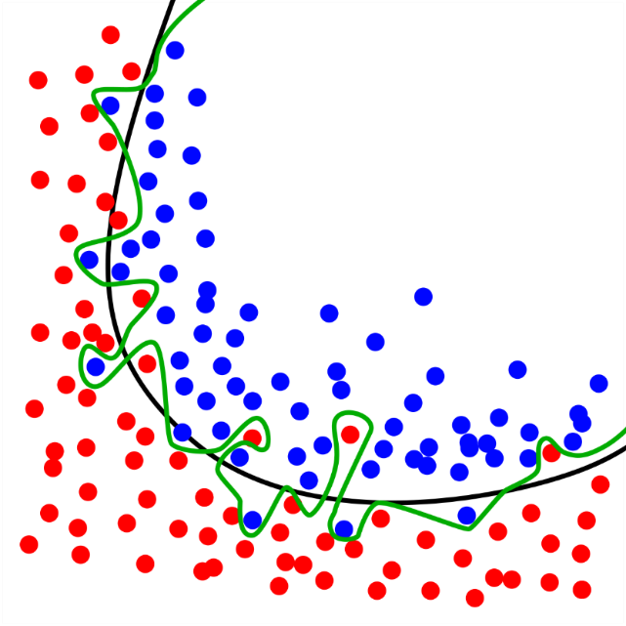
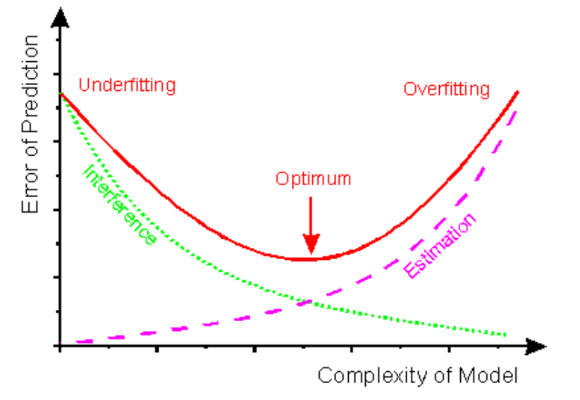
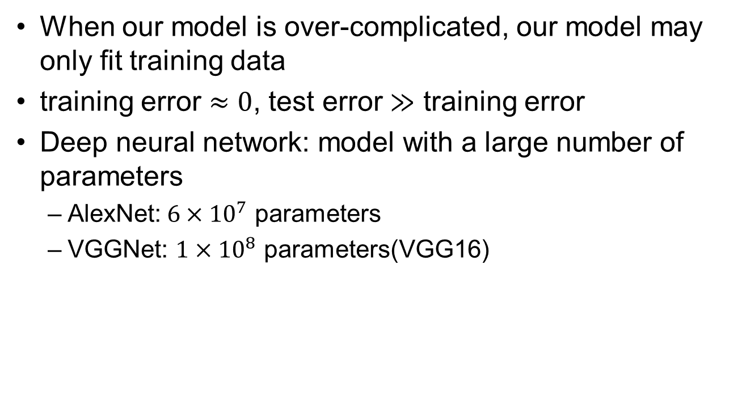
Overfitting
When our model is over-complicated, our model may only fit training data
training error $≈0$, test error $≫$ training error
Deep neural network: model with a large number of parameters
  AlexNet:$6×{10}^{7}$ parameters
  VGGNet: $1×{10}^{8}$ parameters(VGG16)

Slide 16
Some Observations of Deep Nets
Though the model is complicated, deep nets always have benign generalization
For random label or random feature, deep nets converge with 0 training error but without any generalization
How to explain these phenomena?
ICLR 2017 Best Paper:
“Understanding deep learning requires rethinking generalization”

Slide 17
2. Optimization
Empirical Risk Minimization:
$$\min{R_{n}\left(w\right):= \frac{1}{n} \sum_{i}{l(w;x_{i},y_{i})} }$$
Where $(x_{i},y_{i})$ is the data, $w$ is the parameter vector.
Training deep neural network is a non-convex optimization problem
  Local minima
  Saddle points

Slide 18

Optimization
The loss surface is highly non-convex.
Empirically the optimization almost always converge to a very good local minima (Training error $≈0$).
Why GD and SGD always converge to global optimal in such a highly non-convex case?

Slide 19
3. Expressive Power
Expressive power describes neural networks’ ability to approximate functions
Well known result: depth-2 networks with suitable activation function can approximate any continuous function on a compact domain to any desired accuracy
Deep neural networks have much better performance than shallow networks.
Why DEEP is crucial?

Slide 20
Content
Supervised Learning and Deep Learning
Open Problems
Recent Works
Conclusions

Slide 21
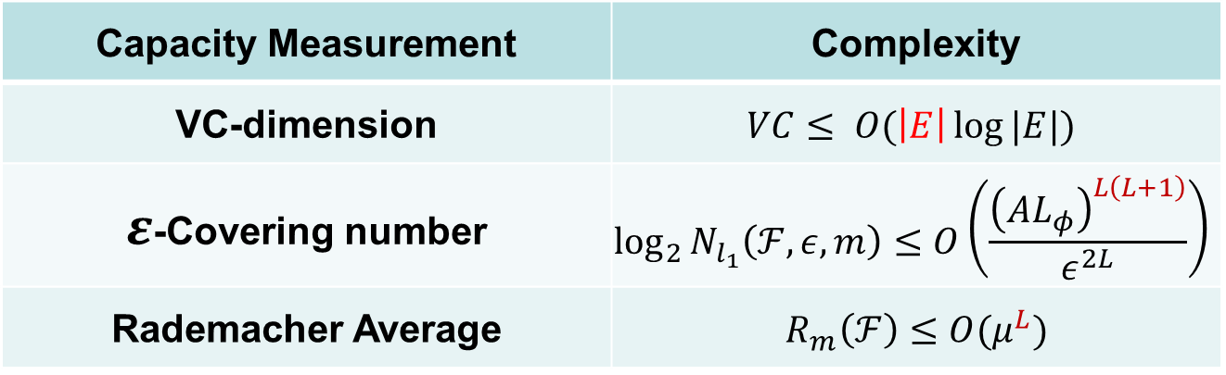
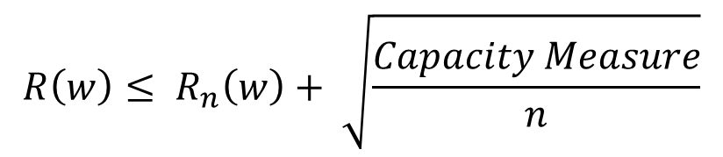
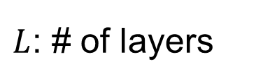
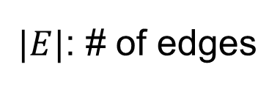
Traditional Learning Theory Fails
Common form of generalization bound (in expectation or high probability)
$$R\left(w\right)≤ R_{n}\left(w\right)+ \sqrt{\frac{Capacity Measure}{n}}$$
Capacity Measurement | Complexity
VC-dimension | $$VC≤ O(\left|E\right|\log{|E|})$$
$ε$-Covering number | $$\log_{2}{N_{l_{1}}\left(ℱ,ε,m\right)≤O\left(\frac{{\left(AL_{φ}\right)}^{L\left(L+1\right)}}{ε^{2L}}\right)}$$
Rademacher Average | $$R_{m}\left(ℱ\right)≤O(μ^{L})$$
$|E|$: # of edges
$L$: # of layers
All these measurements are far beyond the number of data points!

Slide 22
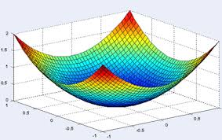
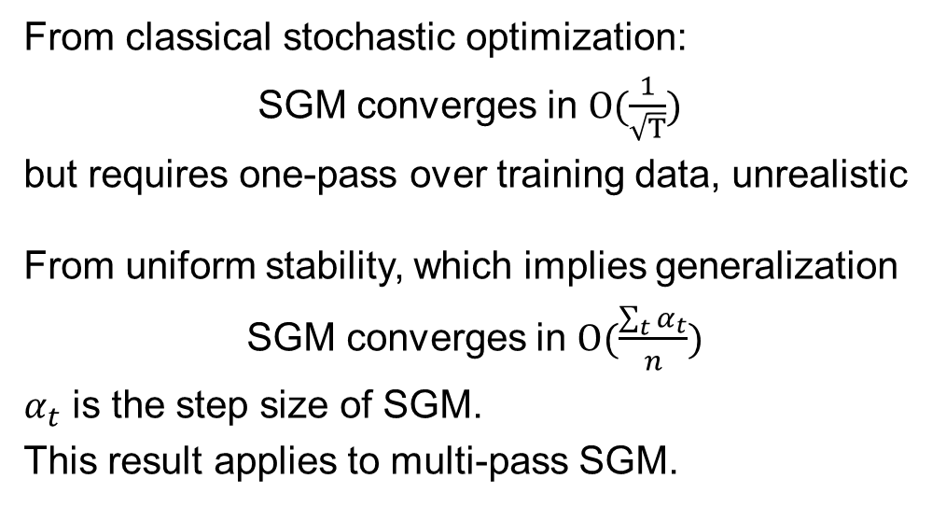
The Generalization Ability Induced by SGD
If we are in convex case, things are easier
From classical stochastic optimization:
SGM converges in $O(\frac{1}{\sqrt{T}})$
but requires one-pass over training data, unrealistic
From uniform stability, which implies generalization
SGM converges in $O(\frac{\sum_{t}{α_{t}}}{n})$
$α_{t}$ is the step size of SGM.
This result applies to multi-pass SGM.

Slide 23
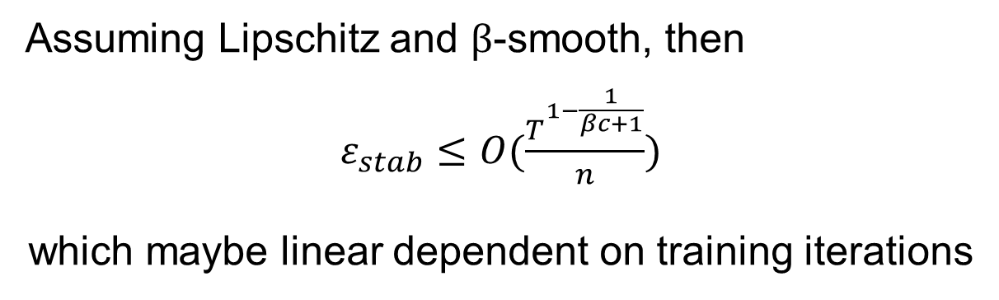
The Generalization Ability Induced by SGD
In nonconvex case, there are some results, but very weak
Hardt et al. (ICML15) , for SGM:
Assuming Lipschitz and $β$-smooth, then
$ε_{stab}≤O(\frac{T^{1−\frac{1}{βc+1}}}{n})$
which maybe linear dependent on training iterations

Slide 24
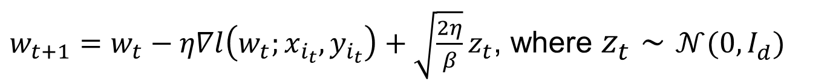
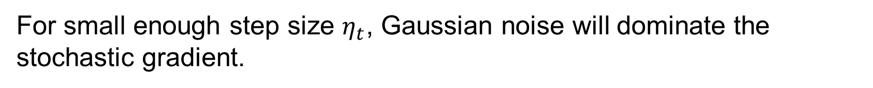
Stochastic Gradient Langevin Dynamics (SGLD)
SGLD is a variant of SGD.
$w_{t+1}=w_{t}−η∇l\left(w_{t};x_{i_{t}},y_{i_{t}}\right)+\sqrt{\frac{2η}{β}}z_{t}$, where $z_{t}∼𝒩(0, I_{d})$
Injection of Gaussian noise makes SGLD completely different with SGD
For small enough step size $η_{t}$, Gaussian noise will dominate the stochastic gradient.

Slide 25
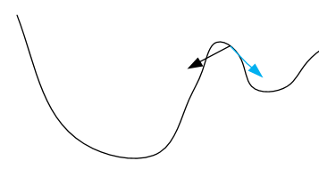
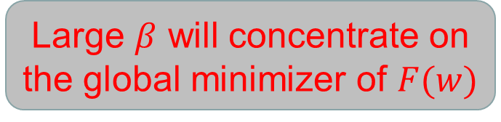
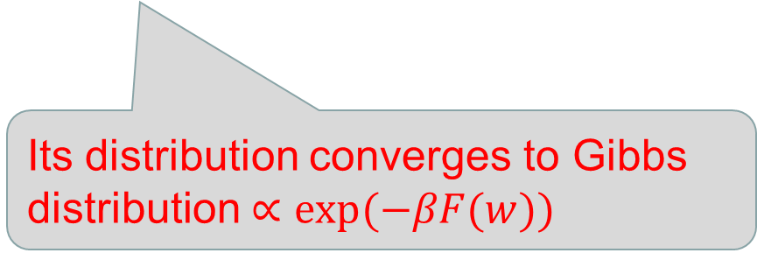
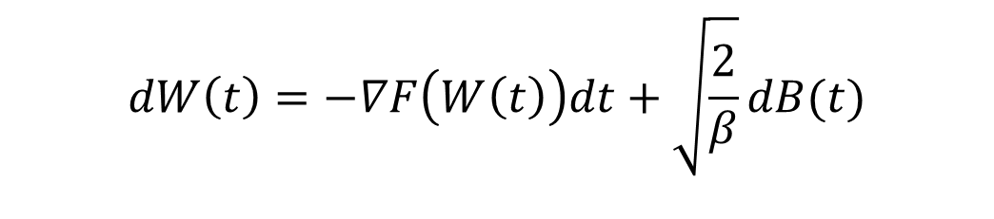
Distinctions of SGLD
Intuitively, injected Gaussian noise helps escape saddle points or local minimum
SGLD is the discretization of following SDE
SG
SG+noise
$$dW\left(t\right)=−∇F\left(W\left(t\right)\right)dt+\sqrt{\frac{2}{β}}dB(t)$$
where $F\left(⋅\right)$ is the empirical loss function, $B(t)$ is the standard Brownian motion
Its distribution converges to Gibbs distribution $∝exp⁡(−βF(w))$
Large $β$ will concentrate on the global minimizer of $F(w)$

Slide 26
Asymptotic VS. Non-asymptotic for SGLD
Asymptotic result requires to run exponential time.
In practice, we can only run the algorithm for poly or even log time.
Thus, we should focus on non-asymptotic properties:
Finite time approximation
Finite discretization
Non-asymptotic results can also guide us to improve existing algorithms.

Slide 27
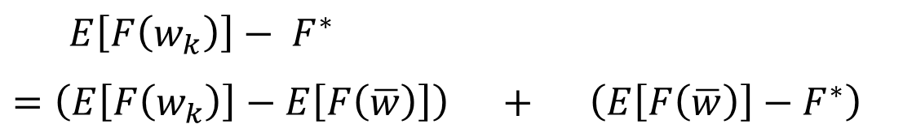
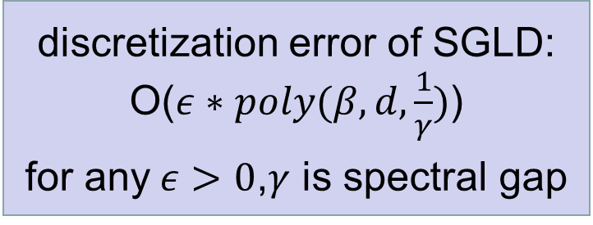
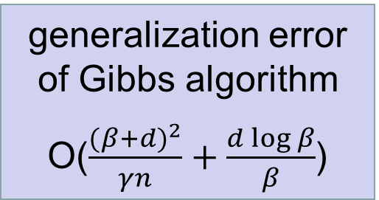
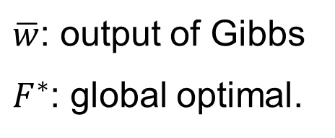
Raginsky et al. (COLT17) decomposed the generalization error as:
$E\left[F\left(w_{k}\right)\right]− F^{∗}$
$=\left(E\left[F\left(w_{k}\right)\right]−E\left[F\left(\overline{w}\right)\right]\right) +$ $\left(E\left[F\left(\overline{w}\right)\right]−F^{∗}\right)$
$\overline{w}$: output of Gibbs
$F^{∗}$: global optimal.
discretization error of SGLD:
O($ε∗poly(β,d,\frac{1}{γ})$)
for any$ε>0$,$γ$ is spectral gap
generalization error of Gibbs algorithm
O($\frac{{(β+d)}^{2}}{γn}+\frac{d\log{β}}{β}$)
However, $\frac{1}{γ}$ may be exponential in $d$, unacceptable!

Slide 28
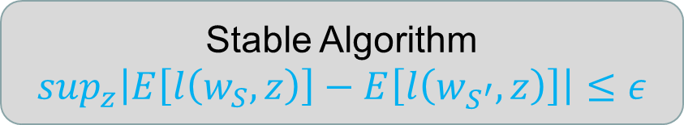
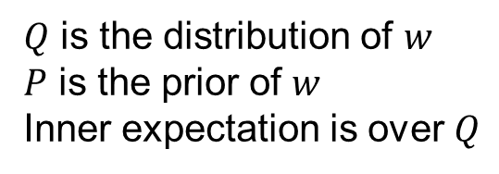
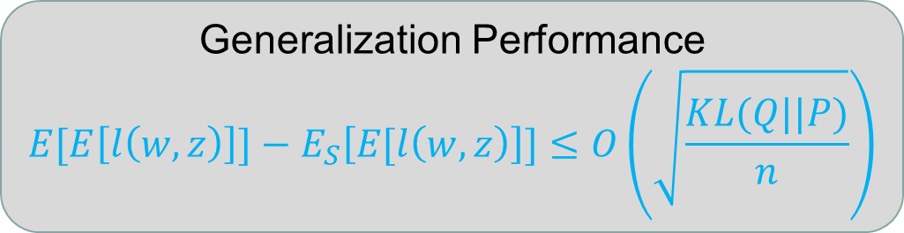
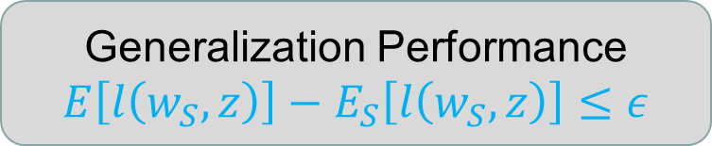
Two Classical Learning Theories for Generalization Error
Algorithmic Stability theory
Stable Algorithm
$$\sup_{z}\left|E\left[l\left(w_{S}, z\right)\right]−E\left[l\left(w_{S^{′}}, z\right)\right]\right|≤ε$$
Generalization Performance
$$E\left[l\left(w_{S}, z\right)\right]−E_{S}\left[l\left(w_{S}, z\right)\right]≤ε$$
PAC-Bayesian theory
Generalization Performance
$$E[E\left[l\left(w, z\right)\right]]−E_{S}\left[E[l\left(w, z\right)\right]]≤O\left(\sqrt{\frac{KL(Q||P)}{n}}\right)$$
$Q$ is the distribution of $w$
$P$ is the prior of $w$
Inner expectation is over $Q$

Slide 29
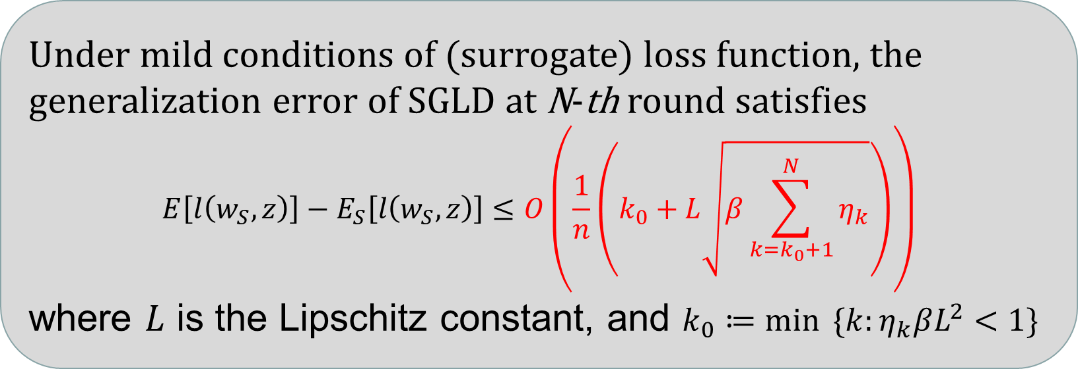
Our Results
From the view of stability theory:
Under mild conditions of (surrogate) loss function, the generalization error of SGLD at N-th round satisfies
$$E\left[l\left(w_{S}, z\right)\right]−E_{S}\left[l\left(w_{S}, z\right)\right]≤O\left(\frac{1}{n}\left(k_{0}+L\sqrt{β\sum_{k=k_{0}+1}^{N}{η_{k}}}\right)\right)$$
where $L$ is the Lipschitz constant, and $k_{0}≔\min{ \{k:η_{k}βL^{2}<1\}}$
If consider high probability form, there is an additional $\tilde{O}\left(\sqrt{1/n}\right)$ term

Slide 30
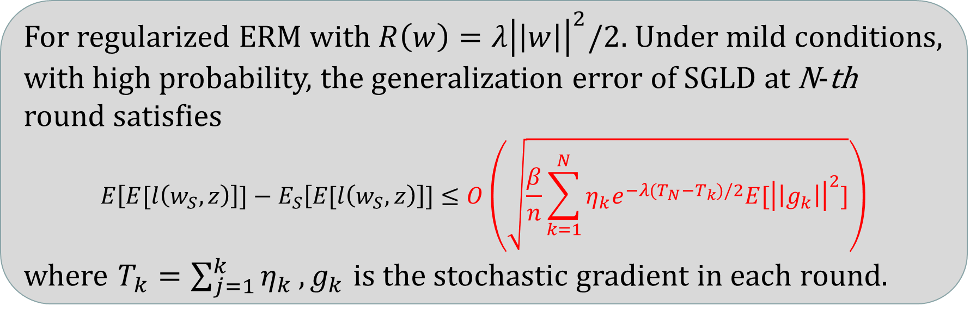
Our Results
From the view of PAC-Bayesian theory:
For regularized ERM with $R\left(w\right)=λ{\left|\left|w\right|\right|}^{2}/2$. Under mild conditions, with high probability, the generalization error of SGLD at N-th round satisfies
$$E\left[E[l\left(w_{S}, z\right)\right]]−E_{S}\left[E[l\left(w_{S}, z\right)\right]]≤O\left(\sqrt{\frac{β}{n}\sum_{k=1}^{N}{η_{k}e^{−λ(T_{N}−T_{k})/2}E[{\left|\left|g_{k}\right|\right|}^{2}]}}\right)$$
where $T_{k}=\sum_{j=1}^{k}{η_{k}}, g_{k}$ is the stochastic gradient in each round.

Slide 31
Comparison Two Results
Both bounds suggest “train faster, generalize better”, which explain the random label experiments in ICLR17
In expectation, stability bound has a faster $O\left(\frac{1}{n}\right)$ rate.
PAC-Bayes bound is data dependent, and doesn’t rely on Lipschitz condition.
Effect of step sizes in PAC-Bayes exponentially decay with time.

Slide 32
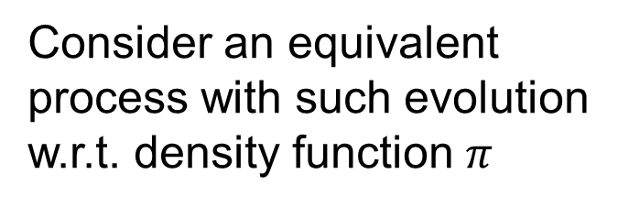

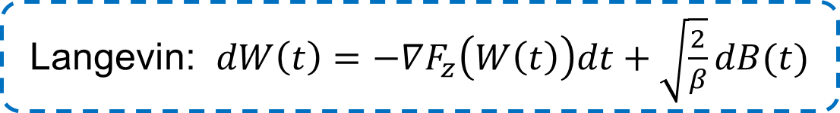

Main Ideas
Suppose $F_{z}\left(W\right)$ is the loss function, ${Ε[g}_{k}]={∇F}_{z}\left(W_{k}\right)$, $ξ_{k}\sim 𝒩(0, I_{d})$
SGLD: $W_{k+1}= W_{k} −ηg_{k}+\sqrt{\frac{2η}{β}}ξ_{k}$
Interpolation
Langevin: $dW\left(t\right)=−∇F_{z}\left(W\left(t\right)\right)dt+\sqrt{\frac{2}{β}}dB(t)$
Consider an equivalent process with such evolution w.r.t. density function $π$
Fokker-Planck: $\frac{∂π}{∂t}=∇⋅ \left(\frac{1}{β}∇π+π∇F_{z}\right)$

Slide 33
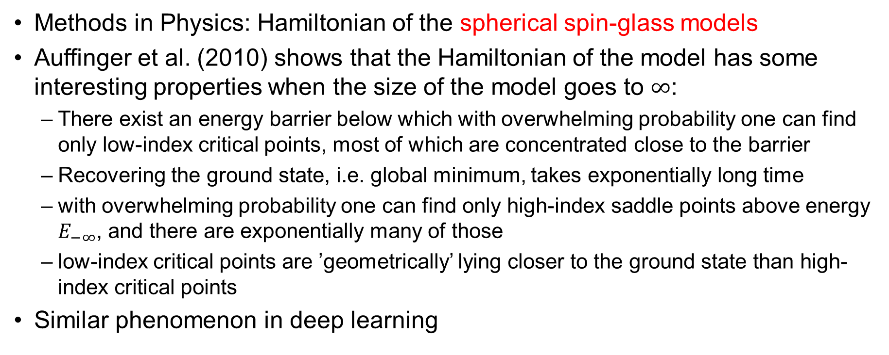
Optimization
Methods in Physics: Hamiltonian of the spherical spin-glass models
Auffinger et al. (2010) shows that the Hamiltonian of the model has some interesting properties when the size of the model goes to $∞$:
  There exist an energy barrier below which with overwhelming probability one can find only low-index critical points, most of which are concentrated close to the barrier
  Recovering the ground state, i.e. global minimum, takes exponentially long time
  with overwhelming probability one can find only high-index saddle points above energy $E_{−∞}$, and there are exponentially many of those
  low-index critical points are ’geometrically’ lying closer to the ground state than high-index critical points
Similar phenomenon in deep learning

Slide 34
Methods in Physics
Under some assumption, Choromanska, et al (2015) try to establish a connection between spin glass model and deep neural networks
Results:
  The critical points with low error form a well-defined band. The number of local minima outside the band diminishes exponentially with the size of the network
  SDG converges to the band of low critical points, and all critical points found there are local minima of high quality measured by the test error
  Recovering the global minimum becomes harder as the network size increase, which may take exponential time

Slide 35
Comments
Meets the fact in practice
Some assumptions are too unrealistic
  Independence between input data and activation of paths
  Independence among input data
Open problem in COLT 2015: to drop unrealistic assumptions and establish a stronger connection between both models

Slide 36
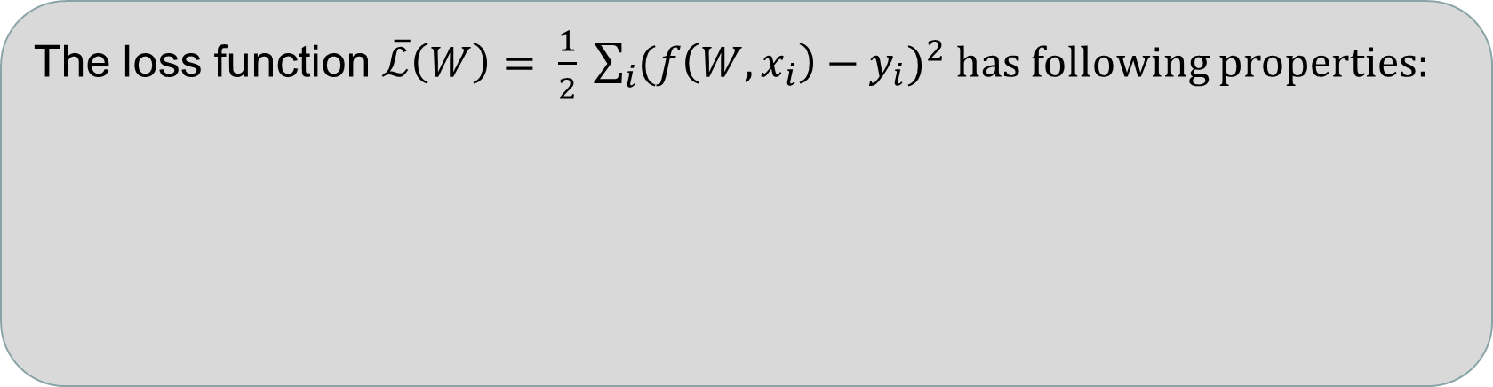


Some Advances
Composite function without activation layer:
$$f\left(W,x\right)= W_{L}W_{L−1}⋯W_{1}x$$
Under some realistic assumptions, Kawaguchi, K. (2016) got following result:
The loss function $\overline{ℒ}\left(W\right)= \frac{1}{2} \sum_{i}{{(f\left(W,x_{i}\right)−y_{i})}^{2}}$ has following properties:
$(i)$ It is non-convex and non-concave.
$\left(ii\right)$ Every local minima is a global minimum.
$(iii)$ Every critical point that is not a global minimum is a saddle point.
$(iiii)$ If $rank\left(W_{L}…W_{2}\right)=p$, then the Hessian at any saddle point has at least one (strictly) negative eigenvalue.

Slide 37

Non-linear Case
Composite function with activation layer:
$$f\left(x\right)= σ_{L}(W_{L}σ_{L−1}(⋯σ_{1}(W_{1}x)))$$
where $σ_{i}\left(x\right)=\max\left(0, x\right), i=1,…,L−1$
Assumptions:
  The activation of the paths are independent of the input
  All the paths have the same probability of activation
Non-linear case can be reduced to linear case under these assumptions.
Remove the unrealistic assumption: Independence among input data

Slide 38



Two-layer Networks (Brutzkus, A., & Globerson, A. 2017)
Neural network with non-overlapping layer:
$$f\left(x;w\right)= \frac{1}{k}\sum_{i}{σ(w⋅x[i])}$$
Assume x is drawn according a standard normal
distribution $𝒢$ in $R^{n}$
Population loss:
$$ℓ\left(W\right)= E_{𝒢}\left[{\left(f\left(x;W\right) −f\left(x;W^{∗}\right)\right)}^{2}\right]$$
$$=\frac{1}{k^{2}}\sum_{i,j}{[g\left(w_{i},w_{j}\right)−2g\left(w_{i},w_{j}^{∗}\right) +g(w_{i}^{∗},w_{j}^{∗})]}$$
where $W^{∗}$ is the global minima, and $g\left(u,v\right)= E_{𝒢}[σ\left(u⋅x\right) σ(v⋅x)]$

Slide 39


Result
No bad local minima.
Polynomial time convergence.
For $k>1, ℓ(w)$ has three critical points:
(a) A local maximum at $w=0$.
(b) A unique global minimum at $w= w^{∗}.$
(c) A degenerate saddle point at $w=−\left(\frac{k^{2}−k}{k^{2}+\left(π−1\right)k}w^{∗}\right).$
Notes:
Deep 比 shallow

Slide 40

Expressive Power
Many works focus on explaining depth efficiency.
Existence of a 3-layer network, which cannot be realized by any 2-layer network to more than a constant accuracy if the size is subexponential in the dimension (Eldan and Shamir 16’)
Existence of classes of deep convolutional ReLU networks that cannot be realized by shallow ones if its size is no more than an exponential bound (Cohen and Sharir et.al.16’)
Explicitly constructed networks with $Θ(k^{3})$ layers and constant width which cannot be realized by any network with $Ο(k)$layers whose size is smaller than $Ω(2^{k})$ (Telgarsky 16’);

Slide 41
Our work: A View from the Width
Width-(n + 4) ReLU networks can approximate any Lebesgue
integrable function
Almost all Lebesgue integrable functions cannot be approximated
by width-n ReLU networks
There exists a family of ReLU networks that cannot be
approximated by narrower networks whose depth increase is no
more than polynomial
where n denotes the input dimension

Slide 42

Main Idea
Divide the restriction of the function f on [-N,N] into positive part $f^{+}$ and negative part $f^{−}$
Approximate $f^{+}$ and $f^{−}$ by equal size cubes
Approximate each cube by a designed depth-(4n+1) width-(n+4) ReLU network

Slide 43


Width Efficiency vs. Depth Efficiency
For integer k, there exist a class of width-$O(k^{2})$ and depth-2 ReLU networks that cannot be approximated by any width-$O(k^{1.5})$ and depth-k networks.
Give a network $𝒜$. We define the amount of parameters in$𝒜$ to be the freedom of$𝒜$.
The core idea of the theorem is that the network with larger freedom is hard to approximated by a network with smaller freedom.

Slide 44
Open Problem: Width Efficiency?
There are wide networks that cannot be approximated by any narrow networks whose size is no more than an exponential bound.
OR
Every wide network can be approximated by a narrow network whose size is no more than a polynomial bound.

Slide 45
Content
Supervised Learning and Deep Learning
Open Problems
Recent Works
Conclusions

Slide 46
Conclusions
Deep learning has received huge success empirically.
But many fundamental problems remain unsolved:
Generalization
Loss surface
Expressive power
Faster and automatic training algorithms
Only when we have some understanding, then it is possible to design better architectures.

Slide 47
The Future of Machine Learning
Applications in Mathematics?
Automated Theorem Proving?

Slide 48
Reference
Cybenko G. Approximation by superpositions of a sigmoidal function[J]. Mathematics of control, signals and systems, 1989, 2(4): 303-314.
Zhang C, Bengio S, Hardt M, et al. Understanding deep learning requires rethinking generalization[J]. arXiv preprint arXiv:1611.03530, 2016.
Bartlett P L, Foster D J, Telgarsky M J. Spectrally-normalized margin bounds for neural networks[C]//Advances in Neural Information Processing Systems. 2017: 6241-6250.
W. Mou, L. Wang, X. Zhai, K. Zheng, Generalization Bounds of SGLD for Non-convex Learning: Two Theoretical Viewpoints, arXiv:1707.05947
Hardt M, Recht B, Singer Y. Train faster, generalize better: Stability of stochastic gradient descent[J]. arXiv preprint arXiv:1509.01240, 2015.
Choromanska A, Henaff M, Mathieu M, et al. The loss surfaces of multilayer networks[C]//Artificial Intelligence and Statistics. 2015: 192-204.

Slide 49
Reference
Choromanska A, LeCun Y, Arous G B. Open problem: The landscape of the loss surfaces of multilayer networks[C]//Conference on Learning Theory. 2015: 1756-1760.
Kawaguchi K. Deep learning without poor local minima[C]//Advances in Neural Information Processing Systems. 2016: 586-594.
Brutzkus A, Globerson A. Globally optimal gradient descent for a convnet with gaussian inputs[J]. arXiv preprint arXiv:1702.07966, 2017.
Wu C, Luo J, Lee J D. No Spurious Local Minima in a Two Hidden Unit ReLU Network[J]. 2018.
Eldan R, Shamir O. The power of depth for feedforward neural networks[C]//Conference on Learning Theory. 2016: 907-940.
Cohen N, Sharir O, Shashua A. On the expressive power of deep learning: A tensor analysis[C]//Conference on Learning Theory. 2016: 698-728.

Slide 50
Reference
Lu Z, Pu H, Wang F, et al. The Expressive Power of Neural Networks: A View from the Width[C]//Advances in Neural Information Processing Systems. 2017: 6232-6240.
A. Auffinger, G. Ben Arous, and J. Cerny. Random matrices and complexity of spin glasses. arXiv:1003.1129, 2010.
Telgarsky M. Benefits of depth in neural networks[J]. arXiv preprint arXiv:1602.04485, 2016.

Slide 51
Thanks!

